Slide 1

ECOSCAN
Plant Disease Detection System

Slide 2

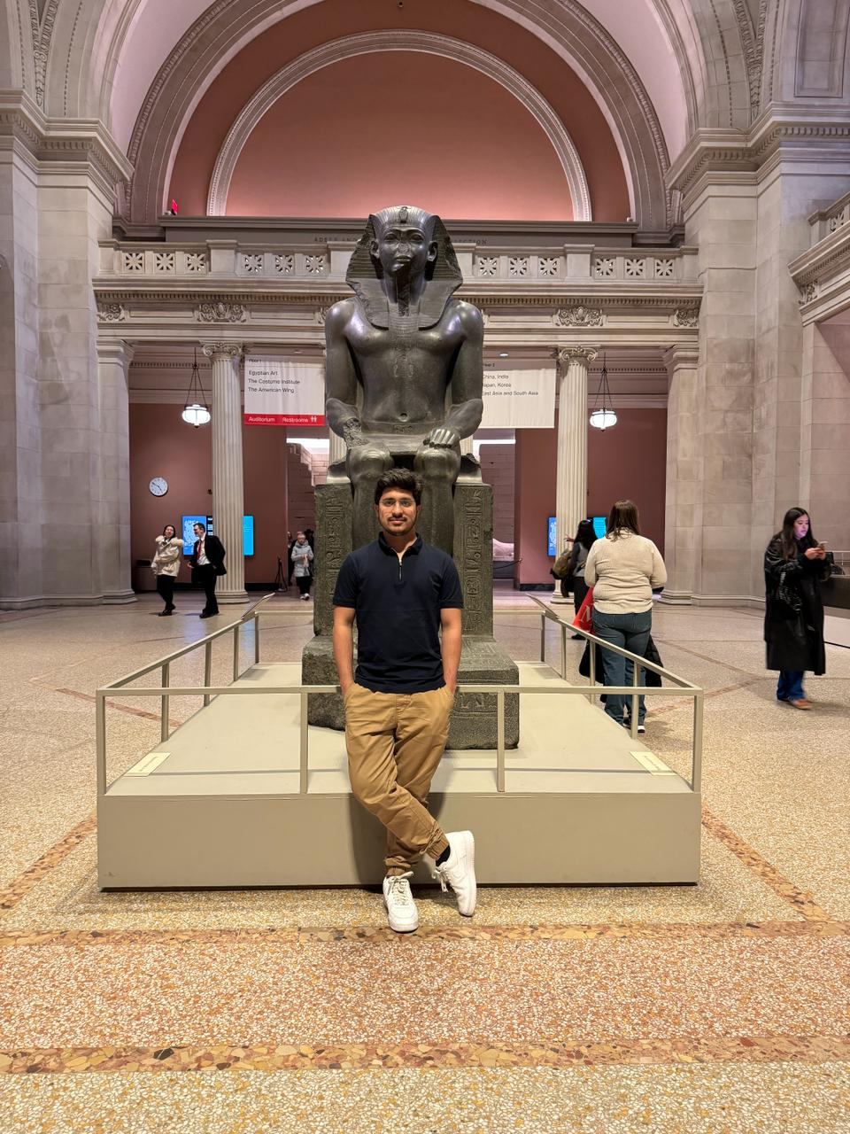

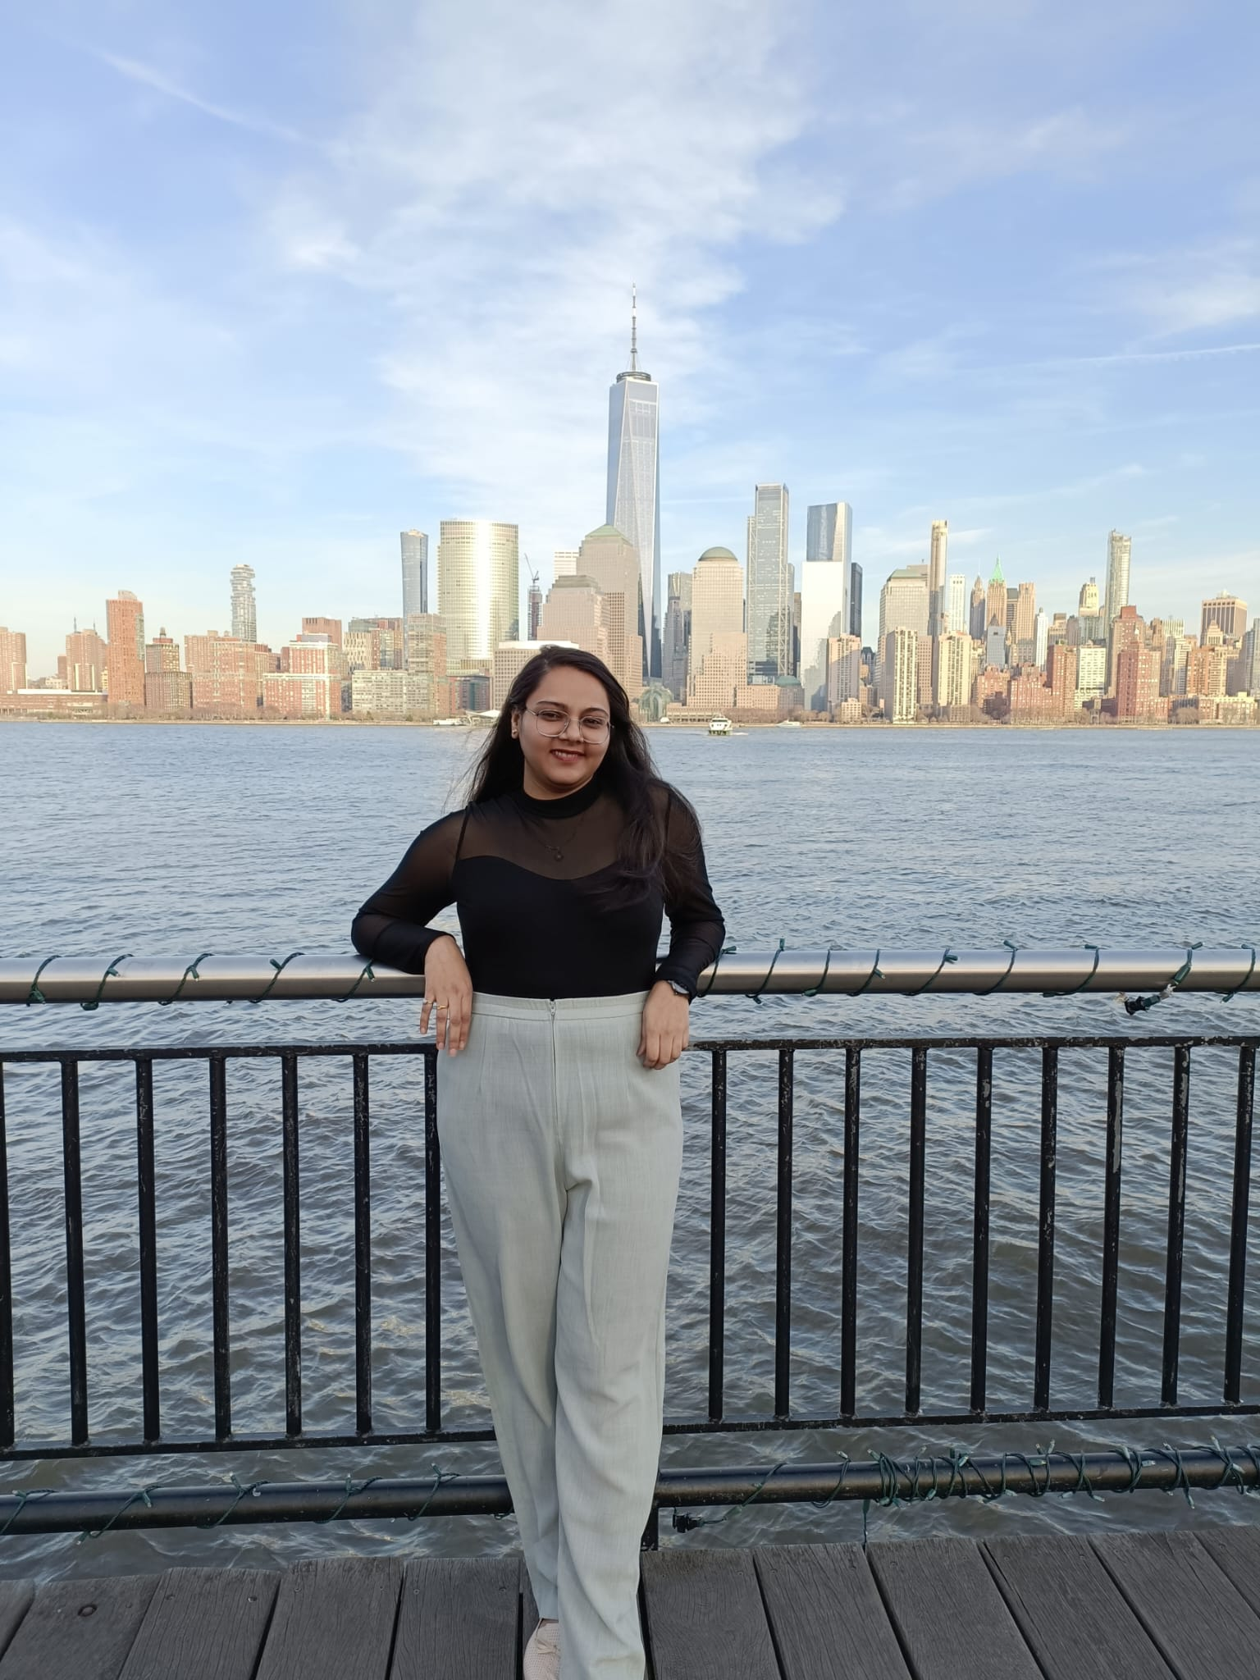

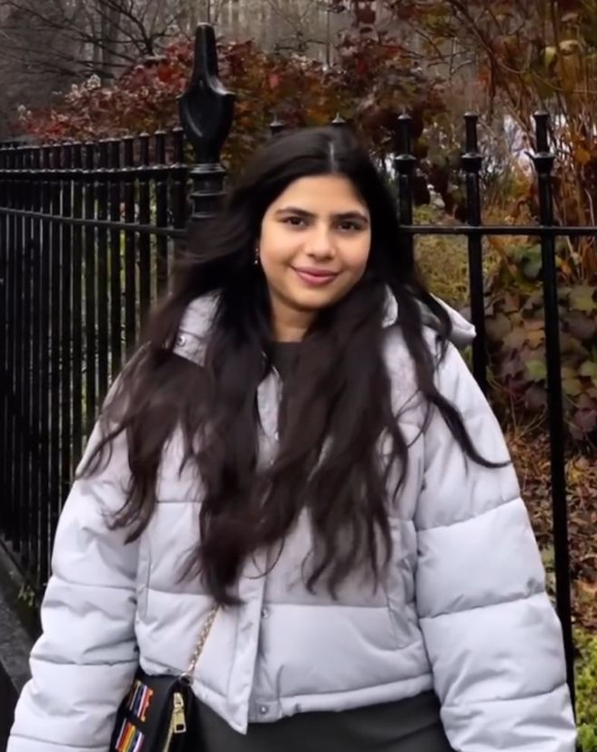

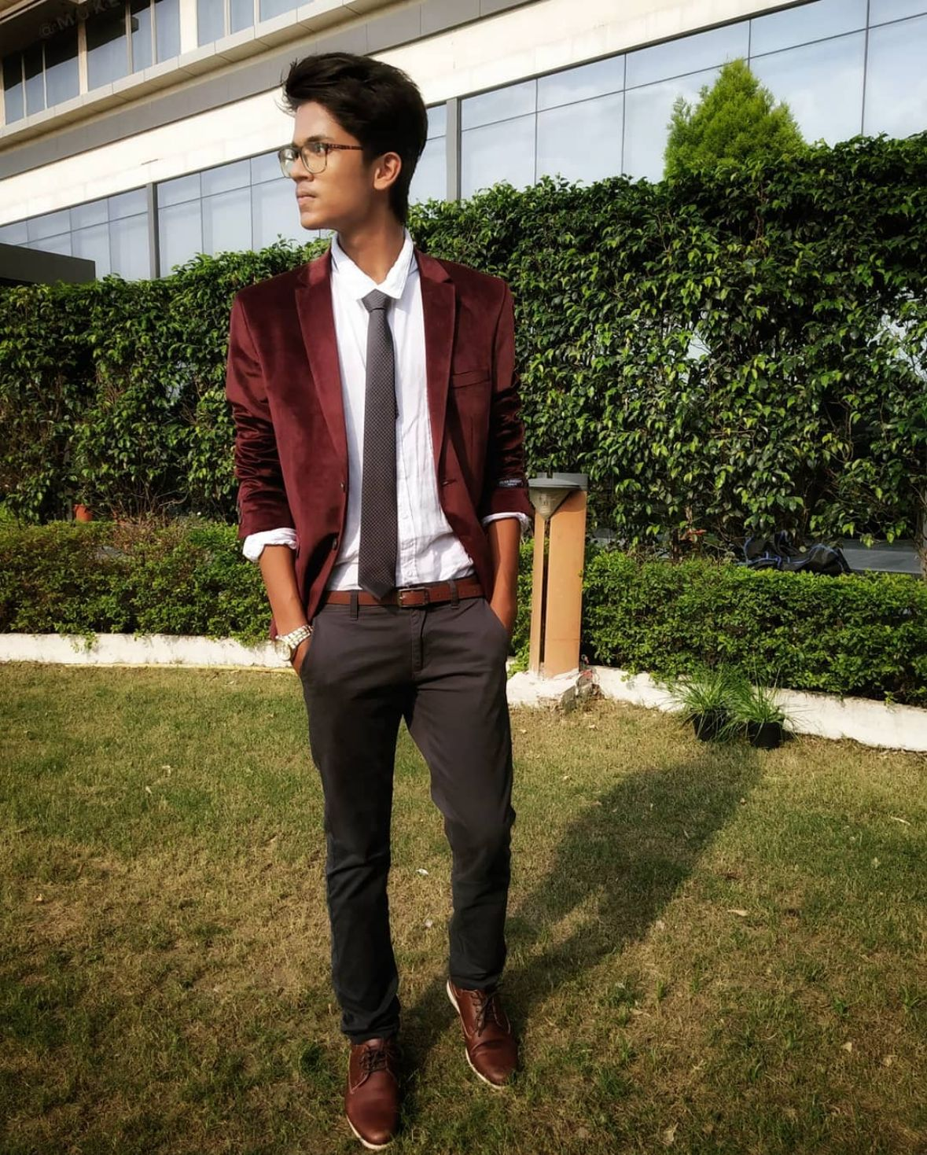
Our Team
Rudra Chobe
Scrum Master
Omkar Gurav
Developer
Shriya Haral
Developer
Ritika Chougala
Developer
Lokeshwar Anchuri
Developer
Niyati Ghagada
Developer
Uma Maheswari Addala
Developer /Tester
Mukesh Suddala
Developer/Quality Assurance

Slide 3
Table of Contents
01.
02.
03.
04.
05.
06.
Problem Statement
Project Description
Personas
10.
Retrospective
Market Analysis
Project Timeline and Tools
MVP
11.
07.
08.
09.
Sprint -3
Project backlog
Test cases and Acceptance criteria
User stories

Slide 4
IMPROVEMENTS MADE FROM PROFESSOR’S FEEBACK
Project schedule for all the sprints
Retrospective video for Sprint -1
Adding roles for each team members
Naming tools and adding where are they used?

Slide 5

PROBLEM WHICH WE ARE ADDRESSING

Slide 6
Problem Statement
The agriculture sector plays a crucial role in sustaining global food security, and plant diseases pose a significant threat to crop yield and quality. Identifying and managing these diseases in a timely and accurate manner is essential for ensuring food production. However, the current methods of plant disease detection often rely on visual inspection by experts, leading to delays in diagnosis and sometimes inaccurate assessments. Additionally, the increasing complexity and variability of plant diseases make it challenging for traditional methods to keep pace with emerging threats. There is a pressing need for advanced and automated plant disease detection systems that can provide rapid, reliable, and precise identification of diseases, enabling farmers to take proactive measures to protect their crops and enhance overall agricultural productivity.

Slide 7
Problem Statement
Furthermore, the economic impact of plant diseases on farmers and the agriculture industry is substantial, with losses stemming from reduced yields, increased use of pesticides, and the potential spread of diseases to neighboring crops. In the face of climate change and global trade, the dynamics of plant diseases are evolving, necessitating a more adaptive and technology-driven approach to diagnosis and management. The development of efficient and scalable plant disease detection solutions that leverage advancements in artificial intelligence, machine learning, and image processing is paramount. By addressing these challenges, we can empower farmers with timely information, minimize crop losses, promote sustainable farming practices, and contribute to the overall resilience of the agricultural sector in the face of emerging plant health threats

Slide 8
Project Description
"Eco Scan" is a pioneering project leveraging Convolutional Neural Networks (CNN) and image processing techniques for rapid and accurate plant disease detection. Using high-resolution images of plants, the system employs advanced CNN algorithms to analyze and identify potential diseases swiftly. The project's primary objective is to provide a user-friendly interface for farmers, allowing them to upload crop images and receive real-time analyses, enabling early disease detection and informed decision-making. By integrating state-of-the-art technology into agriculture, Eco Scan aims to optimize crop health monitoring, minimize losses, and promote sustainable farming practices.

Slide 9
PERSONAS

Slide 10
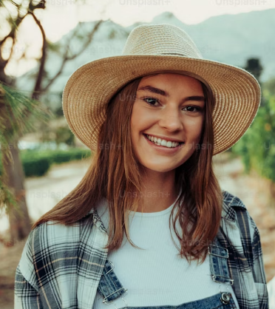
PERSONAS
Ava, the progressive farmer is deep-rooted in the rhythm of the seasons, guiding her farm through cycles of growth and harvest. Yet, she's no stranger to the harsh realities of plant disease and its impact on yield and sustainability. Faced with the complexities of organic farming, she's seeking innovative solutions to protect her crops without resorting to chemical interventions.
Interests
Aside from her passion for sustainable farming, Ava is interested in the latest agricultural technologies that can help optimize organic farming practices.
Frustration
The unpredictability of plant diseases and the limited effectiveness of conventional organic methods in rapid detection and management are her main obstacles.
Goals
Ava is determined to integrate cutting-edge technology into her farming practices to boost productivity while adhering to organic principles.
Name: Ava
Age: 28
Location: Ames, Iowa
Occupation: Owner and
operator of an organic farm
Income: $66,000/annually
Family: Married

Slide 11

PERSONAS
Raj is a visionary in his field, constantly coding and testing the limits of artificial intelligence to serve the earth's farmers. He sees the potential in every line of code to revolutionize traditional farming practices. However, he struggles to find real-world test beds for his algorithms, which are necessary to refine and tailor his solutions to the nuanced needs of agriculture.
Interests
Participating in Hackathons, Coding contests etc.
Practicing yoga and mindfulness
Emerging tech in AI.
Frustration
Access to diverse agricultural data and the hesitancy of the farming community to adopt new technologies are his primary challenges.
Goals
To develop a robust platform that can adapt to various agricultural contexts and improve farm resilience against diseases.
Name: Raj
Age: 30
Location: New York City, NY
Occupation: AI Software
Engineer in Agri-Tech
Income: $120,000/annually
Family: Single

Slide 12
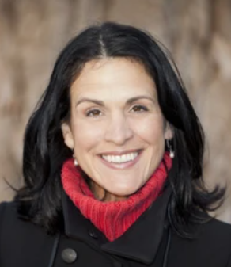
PERSONAS
Claire is a bridge between the agrarian world and the halls of legislation, tirelessly working to shape policies that promote ecological stewardship and technological innovation in farming. She understands the urgency of sustainable agriculture in the face of climate change but is often met with resistance from policymakers reluctant to prioritize or fund these initiatives.
Interests
Enjoys reading about global economic trends.
Organizes educational workshops on sustainability.
Enjoying weekend family outings
Frustration
Her challenge is to navigate the complex political and economic landscapes to secure support and funding for agricultural technology initiatives
Goals
To influence the adoption of sustainable agriculture policies that support and encourage the use of advanced technologies like "Eco Scan."
Name: Claire
Age: 52
Location: Brussels, Belgium
Occupation: Environment Policy Advisor
Income: $70,000/annually
Family: Married

Slide 13
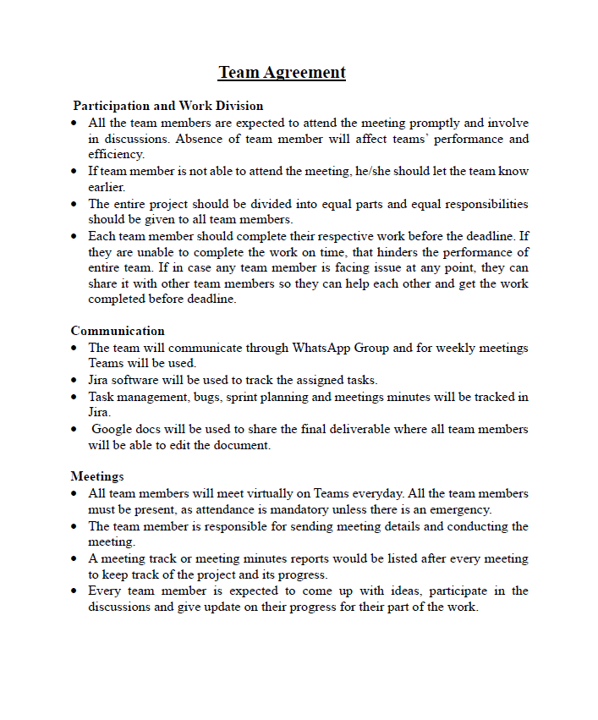
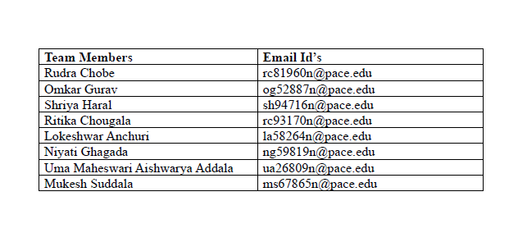
TEAM AGREMENT

Slide 14
MARKET AND BUSINESS ANALYSIS

Slide 15
Business analysis (Things to consider)
Who are the potential stakeholders?
Farmers , agricultural researchers, Technology providers.
What are the existing solutions?
Traditional methods: individual inspections from time to time, lab testing
AL-ML methods: SVM, CV, CNN, Random Forest and many more.
Does it provide cost-to-benefit ratio?
Considering the hardware and software cost to be affordable as right now the hardware and software available is costly.
Solution: Early-stage disease detection as this can help to reduce the manufacturing cost.
How is the user experience right now for the existing products?
Difficult for farmers to understand the interface.
Has bugs which leads to wrong detection of the diseases.
Less accuracy for the providing the solutions for that disease.
Time consuming: Takes a lot of time for loading and processing the data.
Paid subscriptions
Which are existing AI apps and websites?
Blossom AI : Paid subscriptions
PlantSnap : Free trail for 7 days
Plantix: Free
Agriapp: Paid subscription

Slide 16

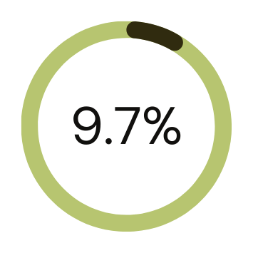
MARKET ANALYSIS
Market Potential: The global agricultural technology market is growing rapidly, with a specific demand for solutions addressing crop diseases. The plant disease detection market is expected to witness substantial growth due to increasing awareness of the impact of diseases on crop yields.
Competitive Landscape: Limited competitors with similar offerings, providing an opportunity for differentiation and market capture.
Regulatory Environment: Compliance with agricultural and environmental regulations will be crucial. Collaboration with agricultural research institutions and government bodies is essential for validation and regulatory approvals.
THE GLOBAL PATHOGEN OR PLANT DISEASE DETECTION AND MONITORING INDUSTRY WAS VALUED AT $1.76 BILLION IN 2022
$1.76 B
EXPECTED TO GROW WITH A CAGR OF 9.68% DURING THE FORECAST PERIOD 2023-2028 TO REACH $3.03 BILLION BY 2028.

Slide 17
What are existing AI-ML Models?
Approach | Method used? | What are the features? | Accuracy | Drawbacks
Image- based Plant Disease detection | CNN | 38 Classes containing crop species and disease Dataset: PlantVillage | 99.35 | Classifying the single leaves
Using Computer Vision and ML Algorithms | DWT+PCA+GLCM+CNN DWT: Discrete Wavelet Transform | 6 classes Tomato plant diseases Dataset: Village(Tomato plant) | 99.09 | Can be used for one plant sample
Using Machine Learning | Logistic Regression, SVM, K-Nearest Neighbour, Random Forest , Naïve Bayes | 160 images of Papaya Leaves using Histogram of an Oriented Gradient (HOG) in MATLAB | Logistic Regression = 65.33, SVM= 40.33, K-Nearest Neighbour= 66.76, Random Forest = 70.14, Naïve Bayes= 57.61 | Less accuracy
Rice plant disease detection using ML | LR, KNN, DT and Naïve Bayes | 3 classes :Bacterial plant blight, Brown spot, and plant smut, each having 40 images | LR= 70.83 KNN= 91.66 DT= 97.91 Naïve Bayes = 50 | Only for Rice plant
Using ML , raspberry and sensors | Lenet-5 | 6 classes Dataset: Plant Village | 99 | Less no of Features .

Slide 18
TOOLS AND WHERE THEY ARE USED

Slide 19










TOOLS AND LANGUAGES
Python
Numpy
OpenCV
Keras
CSS
JIRA
TensorFlow
HTML
Visual Studio
GIT

Slide 20



WHERE ARE THEY USED?
Front End
HTML, CSS: Used for building our website
Visual Studio: For Front end coding
Figma: Used for Designing (Design Interface)
Back End
Keras, Numpy , Tensorflow: ML Libraries used for model building
Python: Used for programming ML Models
Open CV: For object detection
Django : To connect with Front end
Management
JIRA : Planning and workflow
Teams : Daily meetings
WhatsApp : Daily communications
Git : For Source code management

Slide 21
PROJECT SCHEDULE

Slide 22
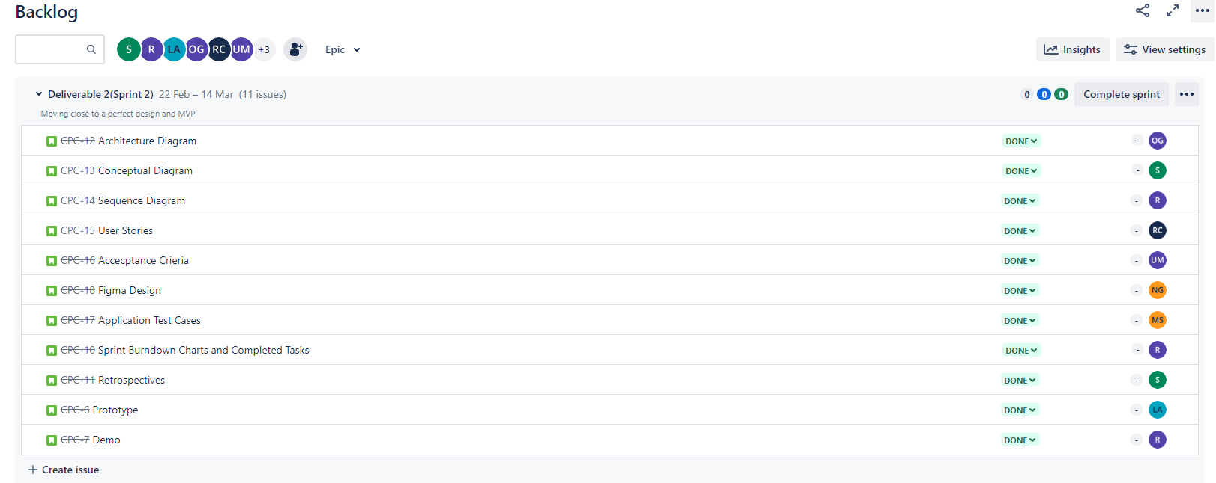
Sprint 2 Schedule

Slide 23
Architectural Diagram

Slide 24
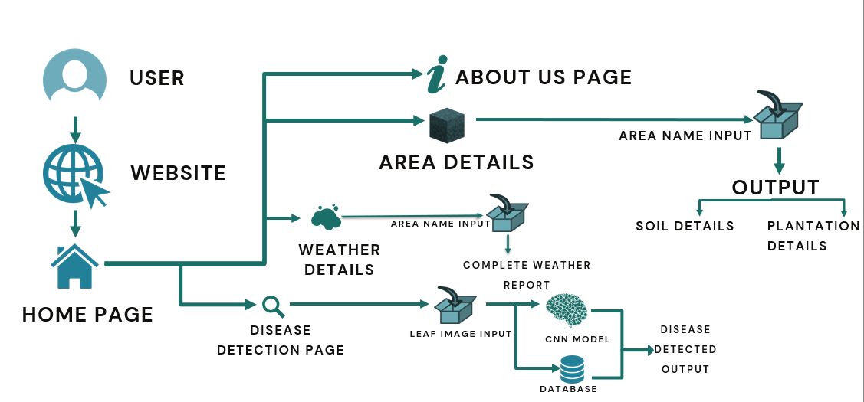
CONCEPTUAL DIAGRAM

Slide 25
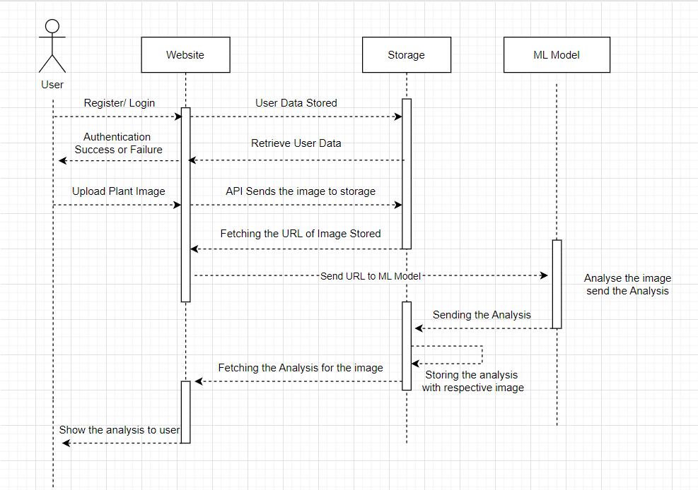
SEQUENCE DIAGRAM

Slide 26
Machine Learning

Slide 27
MACHINE LEARNING
Database: New Plant Disease which contains 84K RBG images
Training Data: 80 %
Testing Data: 20 %
Plant types: 14 (from which we have taken strawberry, orange, pomegranate, Apple, KIWI for now.)
No. of Classes: 38 (while excluding healthy leaves, 26 types of images that show a particular disease in a particular plant).
Model: Vision Transformer model, it is good for image classification which consists of 1 Layer of ViT(Vision transformer) with one flatten layer, 2 batch normalization layer with two dense layer. Total 6 layers.
Metrices: Accuracy and losses
For backend we are using Django framework to connect with front end.

Slide 28
MINIMAL VIABLE PRODUCT

Slide 29
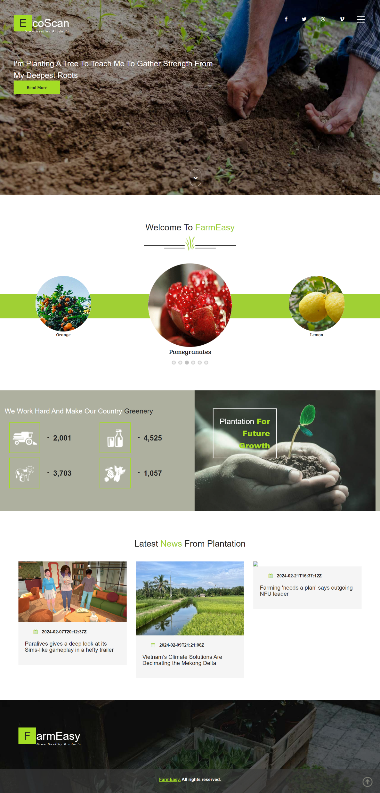
PROTOTYPE
HOMEPAGE
- A welcoming header that introduces the user to the application, setting a positive and inviting tone.
- A section featuring the latest news related to agriculture, keeping users informed about relevant updates and developments.
- Various buttons strategically placed to redirect users to different pages within the application, providing easy access to specific features or sections.
- Conveniently placed links or buttons that swiftly redirect users to the application's social media platforms.
- A dedicated section showcasing statistics related to the application.
HOMEPAGE

Slide 30
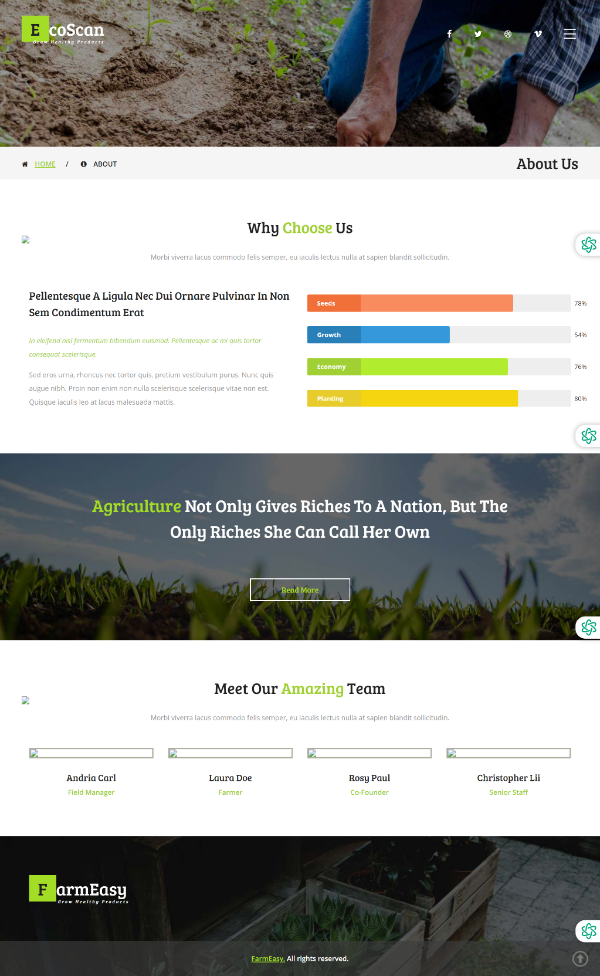
PROTOTYPE
ABOUT US PAGE
- A friendly and inviting introduction at the top of the page, creating a positive tone and making users feel welcomed upon entering the application.
- Clearly labeled tabs, such as 'Home,' 'Area Details,' 'About Us,' etc., facilitating easy navigation and ensuring users can quickly access specific sections of the application.
- A dedicated portion of the page explaining the reasons for users to choose the application. This section likely highlights the unique features, benefits, or values that set the application apart.
- Information about the application's team, providing users with insights into the individuals behind the scenes. This personal touch can enhance trust and connection.
ABOUT US

Slide 31
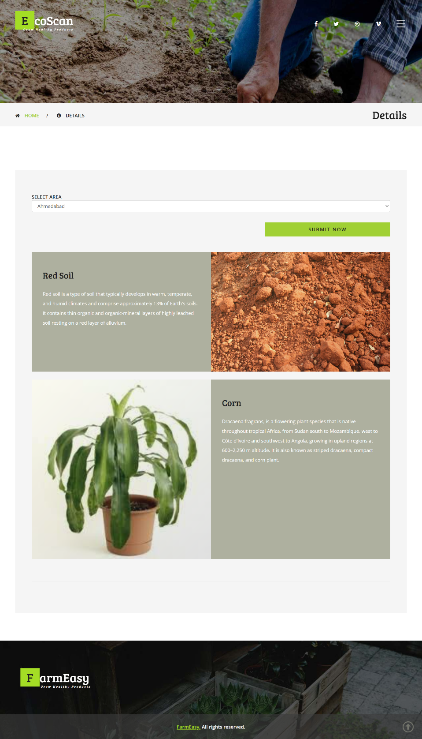
PROTOTYPE
AREA DETAILS
- User-friendly interface allowing users to select their desired area, enhancing customization and providing relevant information based on geographical preferences.
- Detailed information on the soil types in the selected area, aiding users in understanding the soil composition and its suitability for different types of plantations.
- A section suggesting suitable plantations for the chosen area, helping users make informed decisions about what crops or plants thrive in the specific soil conditions of their selected region.
Area Details

Slide 32
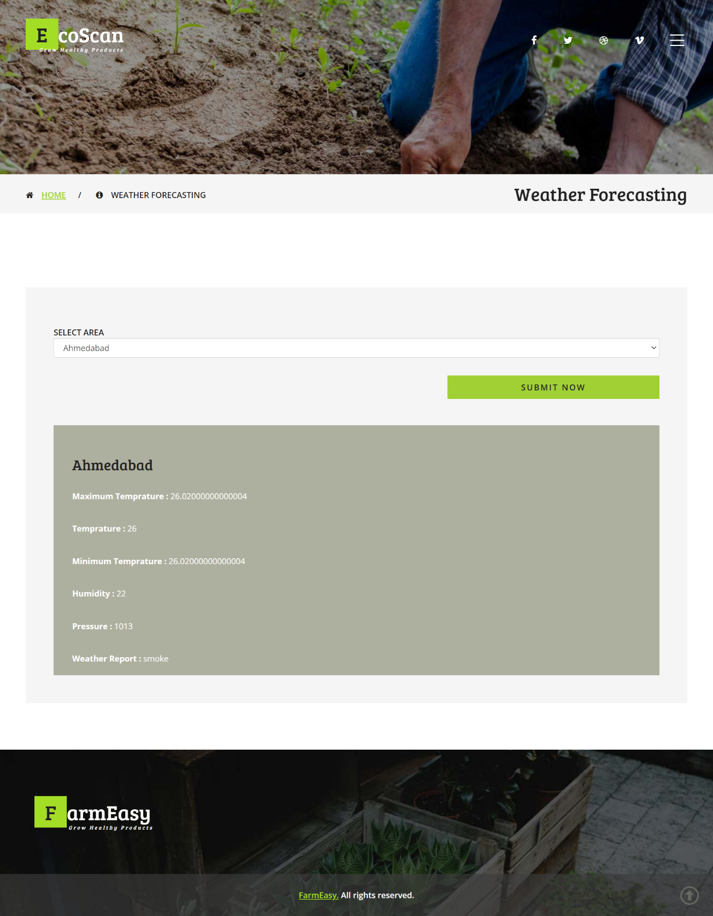
PROTOTYPE
WEATHER FORECAST PAGE
- An interactive feature allowing users to choose a specific area for which they want to check the weather forecast, providing localized and relevant information.
- A visually appealing and user-friendly layout that facilitates easy comprehension of weather data, enhancing the overall user experience.
- The ability to refresh or update the weather information in real-time, keeping users informed with the latest and most accurate forecasts.
- Design considerations to ensure the weather forecast page is accessible and user-friendly across various devices, including desktops, tablets, and cell phones.
Weather Details

Slide 33
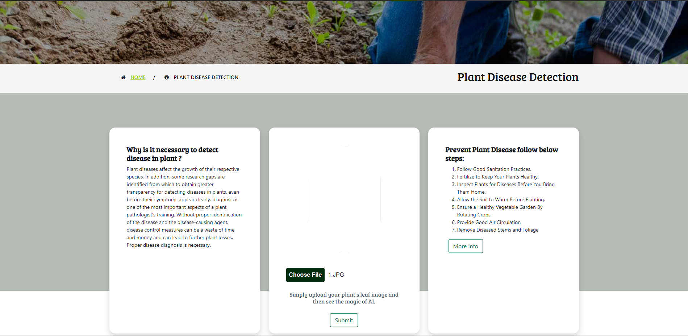
PROTOTYPE
DISEASE DETECTION PAGE
- A user-friendly interface allowing users to upload images of plant leaves for disease detection, promoting ease of use and accessibility.
- Presentation of detected disease name, stage, description, precautions, and recommended supplements based on the uploaded image.
- An informative section explaining the importance of detecting diseases in plants. This could include preventing crop loss, maintaining agricultural productivity, and ensuring overall plant health.
- Clear and concise steps outlined to prevent plant diseases. This may include practices such as regular inspection, timely treatment, and maintaining optimal growing conditions.
- Know Why is it necessary to detect disease in plant ?
- Check Prevent Plant Disease steps.

Slide 34
USER STORIES

Slide 35
User Stories
ID | User Story | Status | Place/Feature
PD-01 | As a user, I want to upload an image of a plant leaf to detect diseases. | To be done | Disease Detection
PD-02 | As a user, I want to receive detailed information about the detected plant disease. | To be done | Disease Detection
PD-03 | As a user, I want to view prescriptions and suggested supplements for the detected disease. | To be done | Disease Detection
PD-04 | As a user, I want to know the various cures and preventive measures for the detected disease. | To be done | Disease Detection
PD-05 | As a user, I want to keep the history of previous detected diseases. | To be done | Disease Detection
PD-06 | As a user, I want to check the current weather conditions in my area. | To be done | Weather Information
PD-07 | As a user, I want to view detailed weather reports and forecasts for agriculture planning. | To be done | Weather Information
PD-08 | As a user, I want to check soil type and recommended plantations for my geographical area. | To be done | Agriculture Details
PD-09 | As a user, I want information about suitable crops and growth conditions for my area. | To be done | Agriculture Details
PD-10 | As a user, I want to see the latest news related to agriculture and farming practices. | To be done | Agriculture News
PD-11 | As a user, I want to receive notifications or updates about my uploaded plant reports. | To be done | Notification System
PD-12 | As a user, I want to explore and learn about new farming technologies and practices. | To be done | Agriculture Information

Slide 36
ACCEPTANCE CRITERIA

Slide 37
ACCEPTANCE CRITERIA
SCENARIO | CRITERIA | SUMMARY
User uploads an image for disease detection | The uploaded image should be in a common image format (JPEG, PNG, etc.) and should contain a clear view of the plant leaf. The system should analyze the image and accurately identify the plant disease. | Ensure that users can conveniently upload plant images, and the system provides accurate disease identification results.
User receives detailed information about the identified disease | Once the disease is identified, the system should display the name of the disease, prevention supplements, disease stage, and other relevant details. | Users should be provided with comprehensive information about the detected plant disease, including preventive measures, disease stage, and additional details for better understanding and management.
User explores reports for a specific area | Users should be able to select a geographical area and view reports related to plant diseases in that region. The system should display a detailed report, including the prevalent diseases, their severity, and any recommended actions. | Allow users to explore plant disease reports for a specific location, enhancing their ability to monitor and manage plant health in different regions.
User checks soil type and plantation details of a selected area | Users should have the option to input a specific location and receive information about the soil type and details of the existing plantation in that area. | Enable users to access valuable insights into the soil conditions and existing plantations in a designated area, supporting informed decision-making for agricultural activities.
User receives notifications for disease outbreaks in a chosen area | Users can subscribe to receive notifications about disease outbreaks in a specific region. The system should send timely alerts, including disease names, severity, and recommended actions. | Enhance user engagement by offering proactive notifications, enabling users to stay informed about potential plant disease threats in their chosen areas.
User provides feedback on the accuracy of disease identification | Users should have the option to provide feedback on the accuracy of disease identification results. The system should use this feedback to continuously improve its plant disease detection algorithms. | Foster user engagement and system improvement by allowing users to contribute feedback, creating a dynamic and responsive ecosystem for disease detection.

Slide 38
TEST CASES

Slide 39
TEST CASES
Unit to Test | Scenario Test | Data Expected | Results
Image Upload Functionality | User uploads a valid image of a plant leaf. | The system should identify the disease, display prevention supplements, stage, and details. | In Progress
 | User uploads an invalid image format. | The system should prompt an error message indicating the unsupported format. | The system correctly handles the invalid format and prompts the user with an appropriate message.
 | User uploads an image that is not a plant leaf. | The system should prompt an error message indicating that the uploaded image is not valid. | The system correctly identifies the invalid content and provides a relevant error message.
Area Report Functionality | User requests a report for a specific area. | The system should display information on diseases, soil type, and plantation details for the area. | In Progress
 | User requests a report for an invalid or non-existent area. | The system should prompt an error message indicating that the area is not found. | The system correctly handles the request for an invalid or non-existent area.
Soil Type and Plantation Details | User selects an area to view soil type and plantation details. | The system should display accurate information about the soil type and plantation in that area. | In Progress
 | User selects an area with no available data. | The system should inform the user that no data is available for the selected area. | The system correctly handles the scenario where no data is available for the selected area.

Slide 40
TEST CASES
Unit to Test | Scenario Test | Data Expected | Results
User Interface and Navigation | User navigates through the website without uploading an image. | The system should provide a user-friendly interface with clear navigation options. | The system correctly presents a user-friendly interface, allowing smooth navigation.
 | User attempts to access restricted areas without proper authentication. | The system should prompt the user to log in before accessing restricted areas. | The system correctly enforces authentication for restricted areas.
Prevention Supplements Information | User views prevention supplements for a specific disease. | The system should display accurate information on prevention supplements for the disease. | In Progress
 | User views prevention supplements for a disease with no available data. | The system should inform the user that no data is available for prevention supplements. | The system correctly handles the scenario where no data is available for prevention supplements.
Disease Stage Information | User checks the stage of a detected disease. | The system should show the current stage of the detected disease. | In Progress
 | User checks the stage of a healthy plant (no disease detected). | The system should indicate that the plant is healthy and not in any disease stage. | The system correctly identifies and communicates that the plant is healthy with no disease stage.
Area Report with Historical Data | User requests a historical report for a specific area. | The system should provide historical data on diseases, soil type, and plantation details. | In Progress
 | User requests a historical report for an area with no historical data. | The system should inform the user that no historical data is available for the area. | In Progress

Slide 41
TEST CASES
Unit to Test | Scenario Test | Data Expected | Results
User Profile and Preferences | User updates their profile information. | The system should reflect the updated user profile information. | In Progress
 | User sets preferences for notification alerts. | The system should send notification alerts based on the user's preferences. | In Progress
Feedback and Support | User submits feedback through the website. | The system should receive the feedback and store it for analysis. | In Progress
 | User accesses the support section for assistance. | The system should provide relevant support information and contact details. | In Progress

Slide 42
PROJECT BACKLOG

Slide 43
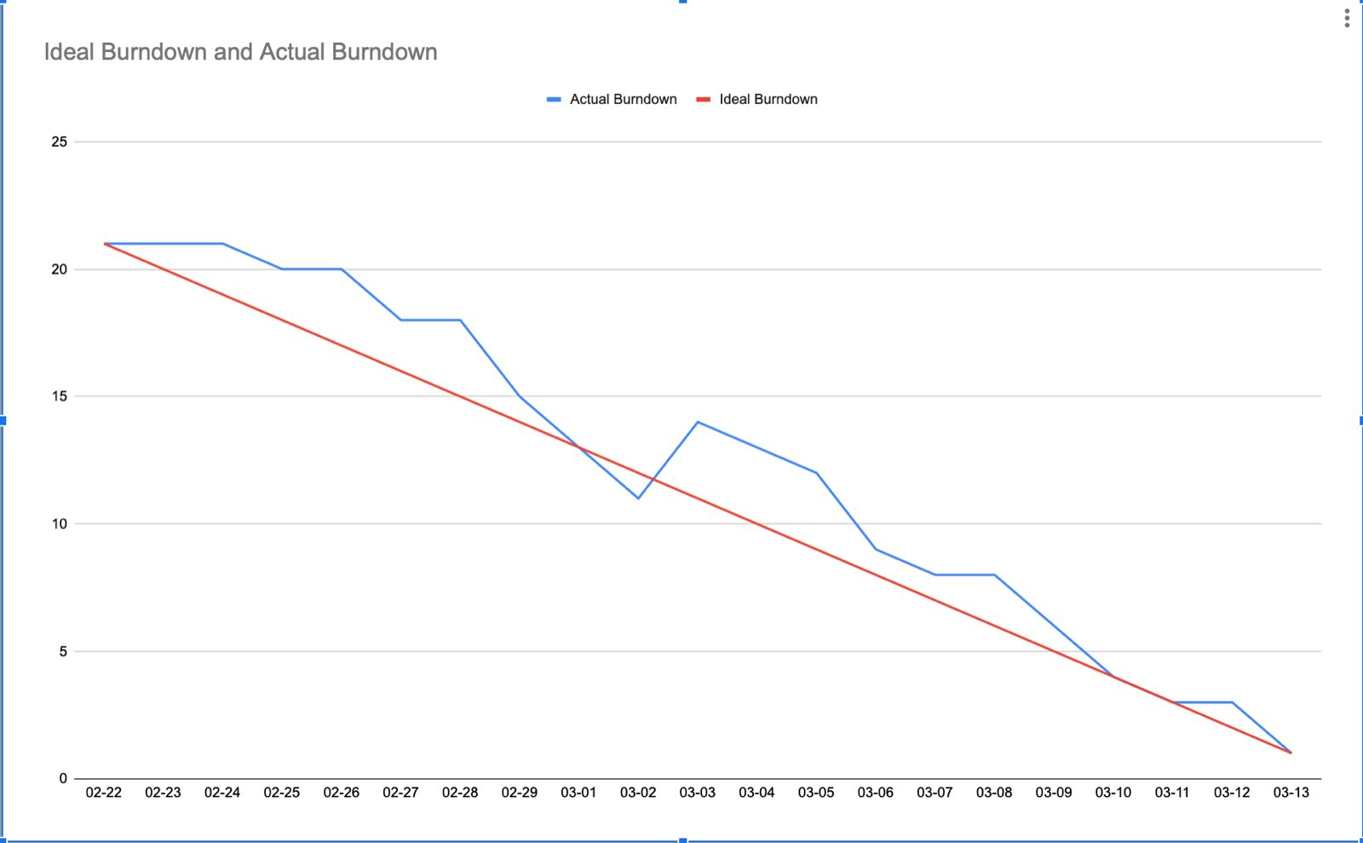
BURNDOWN CHART

Slide 44
RETROSPECTIVE

Slide 45
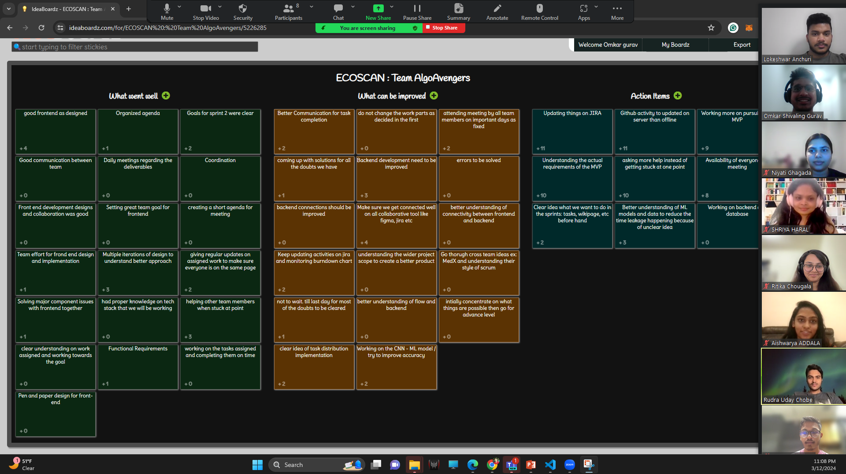
IDEA BOARD

Slide 46
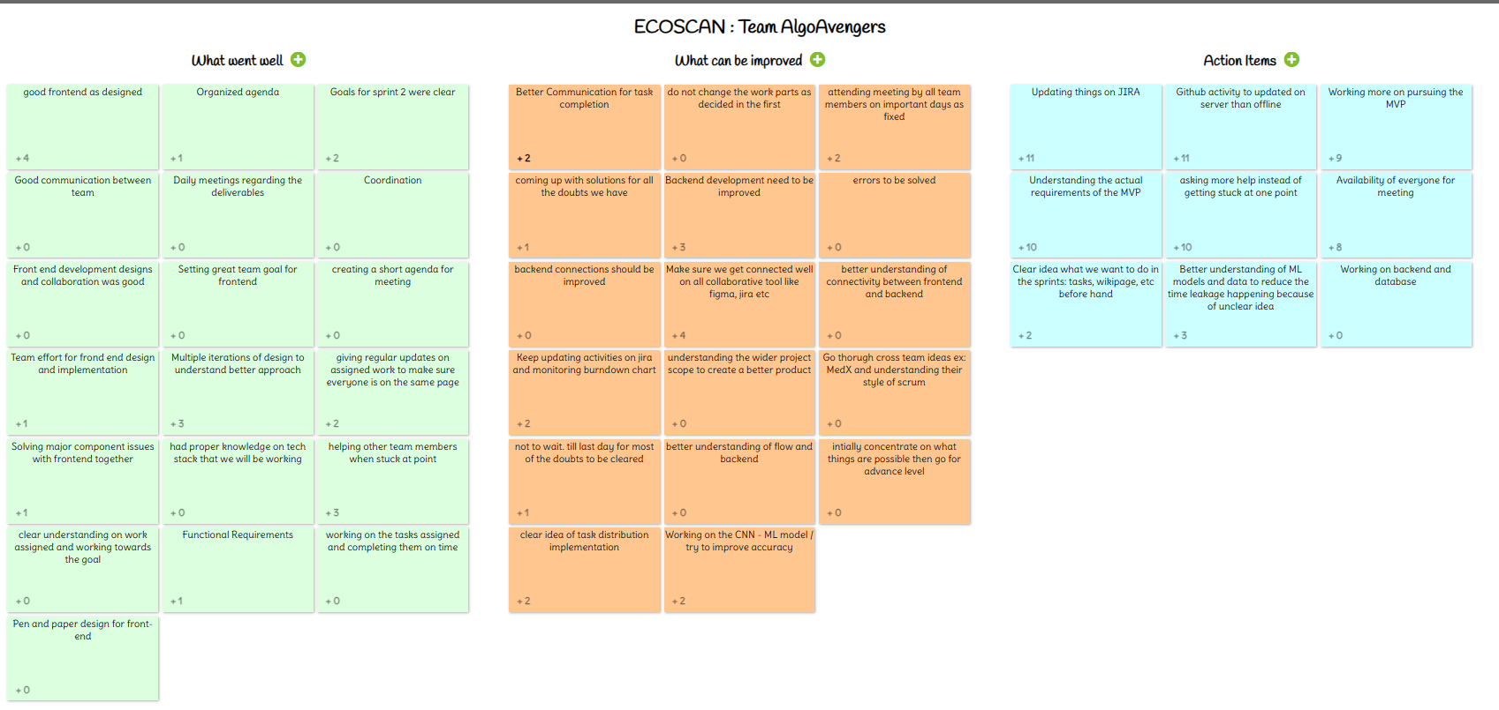
IDEA Board

Slide 47

What went well?
Good front end as planed and designed.
Multiple iterations of design to understand better approach.
Helping other team members when stuck at point
Goals for sprint 2 were clear.
Giving regular updates on assigned work to make sure everyone is on the same page.

Slide 48
What can be improved?
Making sure that we get connected well on all collaborative tools like figma, jira, etc.
Backend development needs to be improved.
Better communication for task completion.
Attending meeting by all team members on important days as fixed.

Slide 49
Action Items?
Updating things on JIRA
Github activity to be updated on server than local machine.
Understanding the actual requirements of the MVP
Better understanding of ML models and data to reduce time and data leakage because of unclear idea.

Slide 50
PLAN FOR SPRINT 3

Slide 51
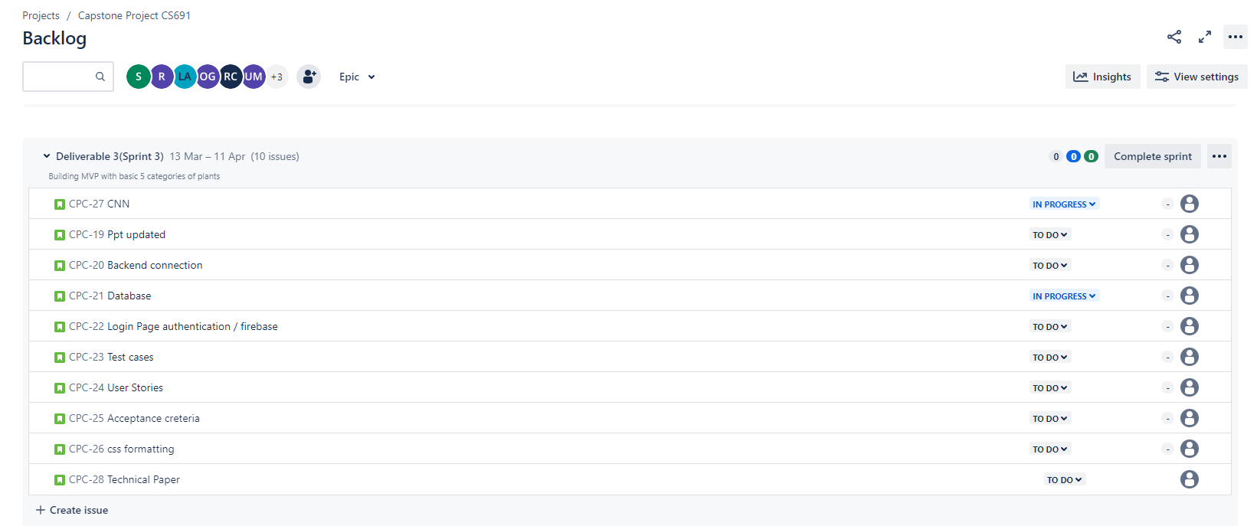
PLAN FOR SPRINT 3

Slide 52
PROJECT DEMO

Slide 53
Wiki Page Link
https://github.com/htmw/2024S-AlgoAvengers

Slide 54


THANK YOU

